Slide 1

6502 Debugger
Haley Whitman
Frazer Bayley
Alison Legge
Jeremy Brennan
Abdualziz AL-Heidous
CIS 422 – Dr. Faulk

Slide 2
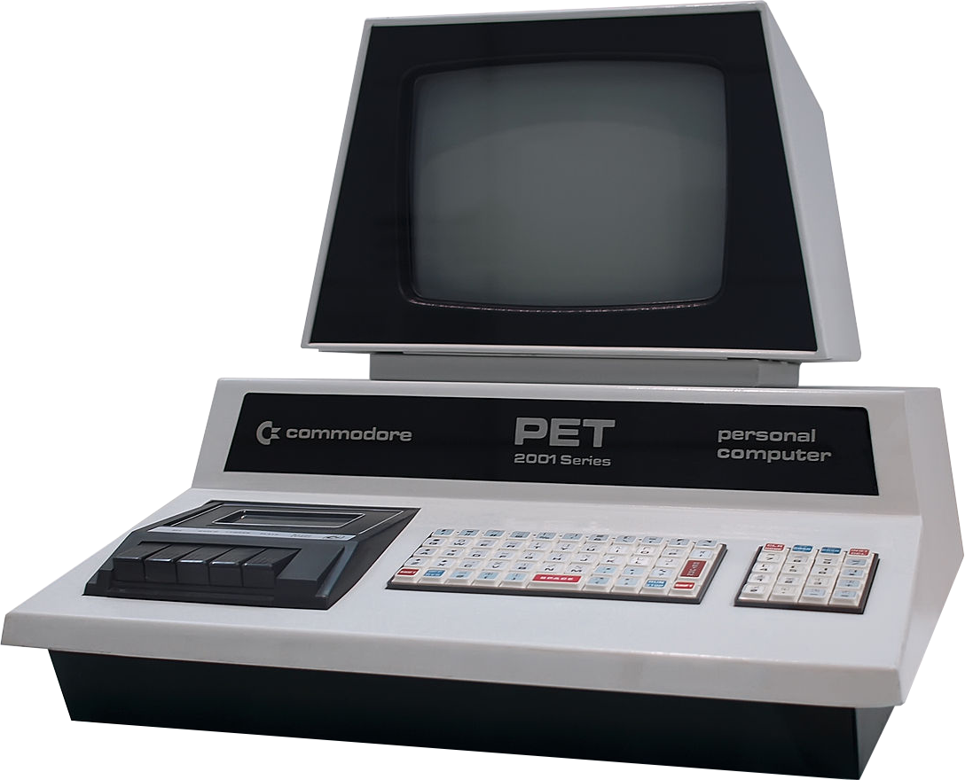
Background
Project is split into two deliverable parts
MOS Technology 6502 Processor
Debugging Interface for 6502 Assembly
Requirements for 6502 Processor
Accurately emulate the behavior of a 6502 processor.
Allow for third-party control of the processor.
Requirements for the debugging interface
1. Allow for a user to input 6502 assembly
2. Allow for the user to view the results, and step through their inputted program.

Slide 3
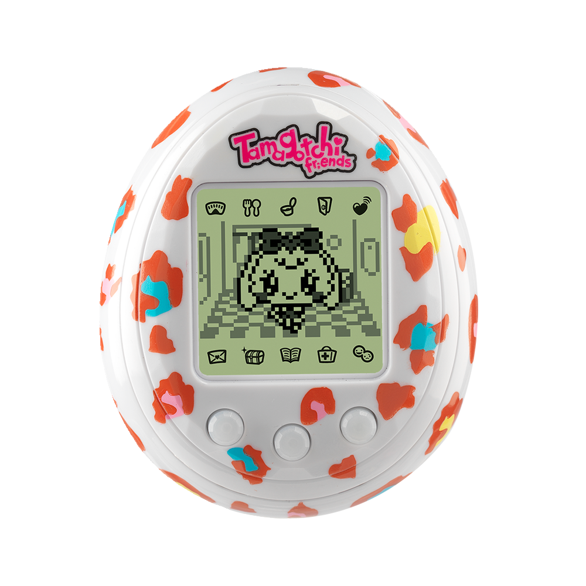
Project Plan
Followed an iterative design, split between
Creating the processor.
Creating the debugging interface.
We created the module design for the processor from Synertek and MOS Technology’s 6502 Programming/Hardware manual.
We followed customer requests and typical debugging use-cases to design the debugging interface. Our documentation focused much more heavily on the debugging interface.

Slide 4
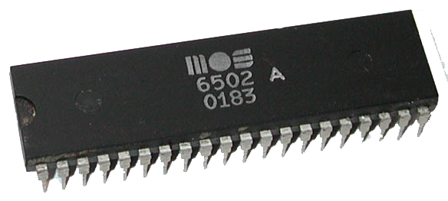
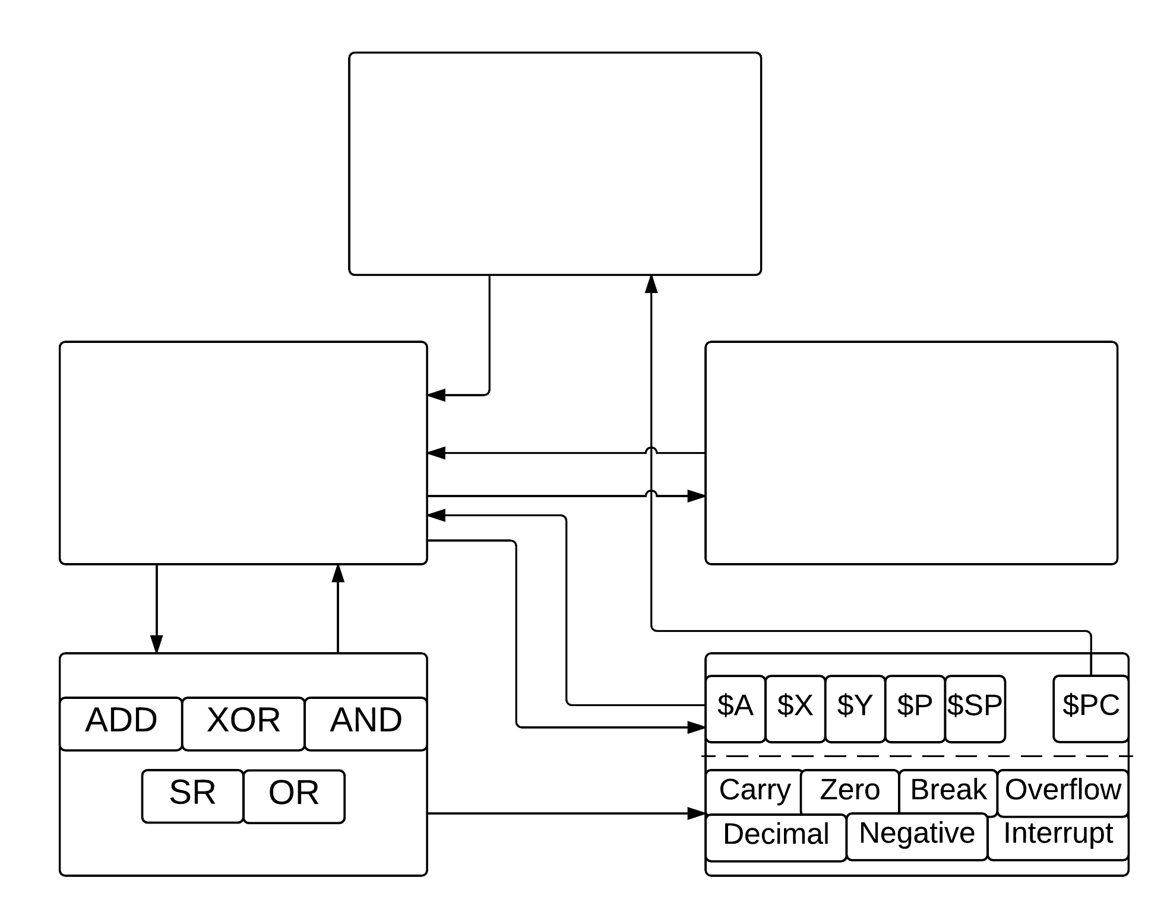
Central Processing Unit (CPU)
Processor Design
Allows control of processor by third-party applications. Decodes current instruction.
Fairly typical design specification
Follows original dataflow of 6502 processor
Instructions
Memory
1-to-1 mapping of 156 standard 6502 instructions.
Contains read/writes of standard 6502 memory. (16Kb of memory)
Arithmetic Logical Unit (ALU)
Registers

Slide 5
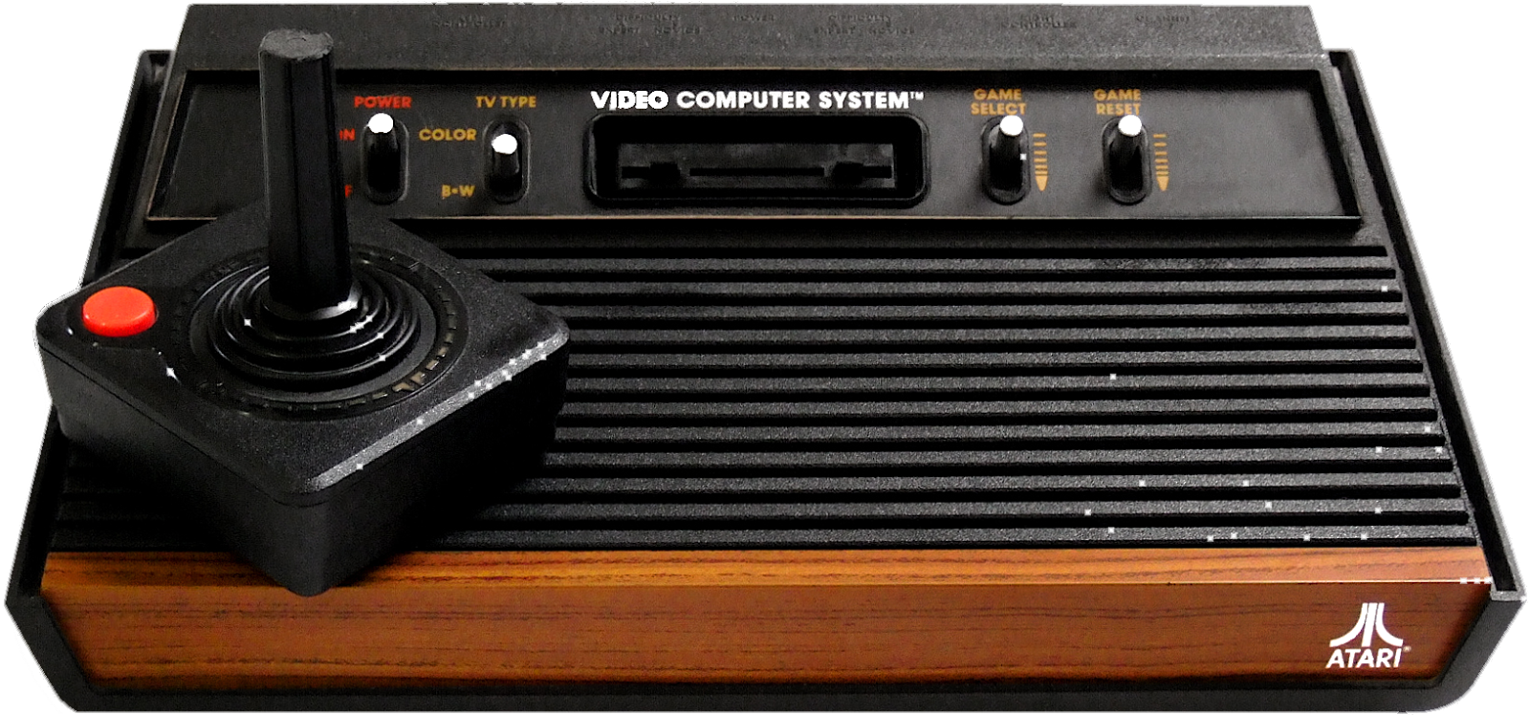
Debugging Design
Fairly typical debugging interface,
modeled after more retro-based debuggers for processors such as the Gameboy, where analyzing memory output is helpful.
Has to easily allow for further features.

